Slide 1
Retail Recommender Solution Offering
Notes:
Today we want to talk to you about how Microsoft can help you to use AI to strengthen your ability to personalize the customer experience across your retail channels.
Let’s talk about business landscape changes that will continue to impact retail.

Slide 2



Technology is driving the demand for personalization
Empower your employees
Embrace the new normal
of consumers say friendly and/or knowledgeable employees are most important aspect of in-store customer service.¹
of consumers have tried a new shopping experience or approach since COVID and intend to continue.³
62%
1
75%
a
3
e
c
o
e
p
DATA
f
h
2
r
s
v
g
k
t
u
Reimagine retail
x
Know your customer
l
j
w
4
AI-native shoppers (currently ages 5 to 9) are expected to give up product research in favor of relying on AI to provide best offerings preselected for them.²
n
m
aa
y
of consumers are more likely to shop at retailers and brands providing a personalized experience.⁴
bb
650M
cc
dd
78%
1) 10 Important Ecommerce Trends to Watch for in 2021 - Oberlo
2) 5 predictions for the future of retail | Retail Dive
3) McKinsey & Company, The Great Consumer Shift
4) The ICSC Customer Service Survey. ICSC, 2019
Notes:
Market Challenge
Customer needs have always driven retail, but today customers expect more—personalized and on-demand service from the moment their path crosses yours, in-person or online.
Giving customers the experience they expect requires a lot more innovation than it used to—and a lot more access to data.That shift is reflected in the numbers:
78% of consumers are more likely to shop at retailers with a personalized experience
Some of the most desirable demographic groups--high-income earners and millennials--are leading the way in shifting spend online across both essential and nonessential items, (The great consumer shift: Ten charts that show how US shopping behavior is changing | McKinsey)
Retailers that cannot successfully leverage prescriptive product recommendations will find themselves off-boarded. Not only will they lose existing customers, they won't be able to attract new customers due to their lack of relevancy and ability to influence.
It's easy to see the impacts digital transformation will have on retail. But let's go further and take a look at some of the common challenges retailers are having using data today.

Slide 3
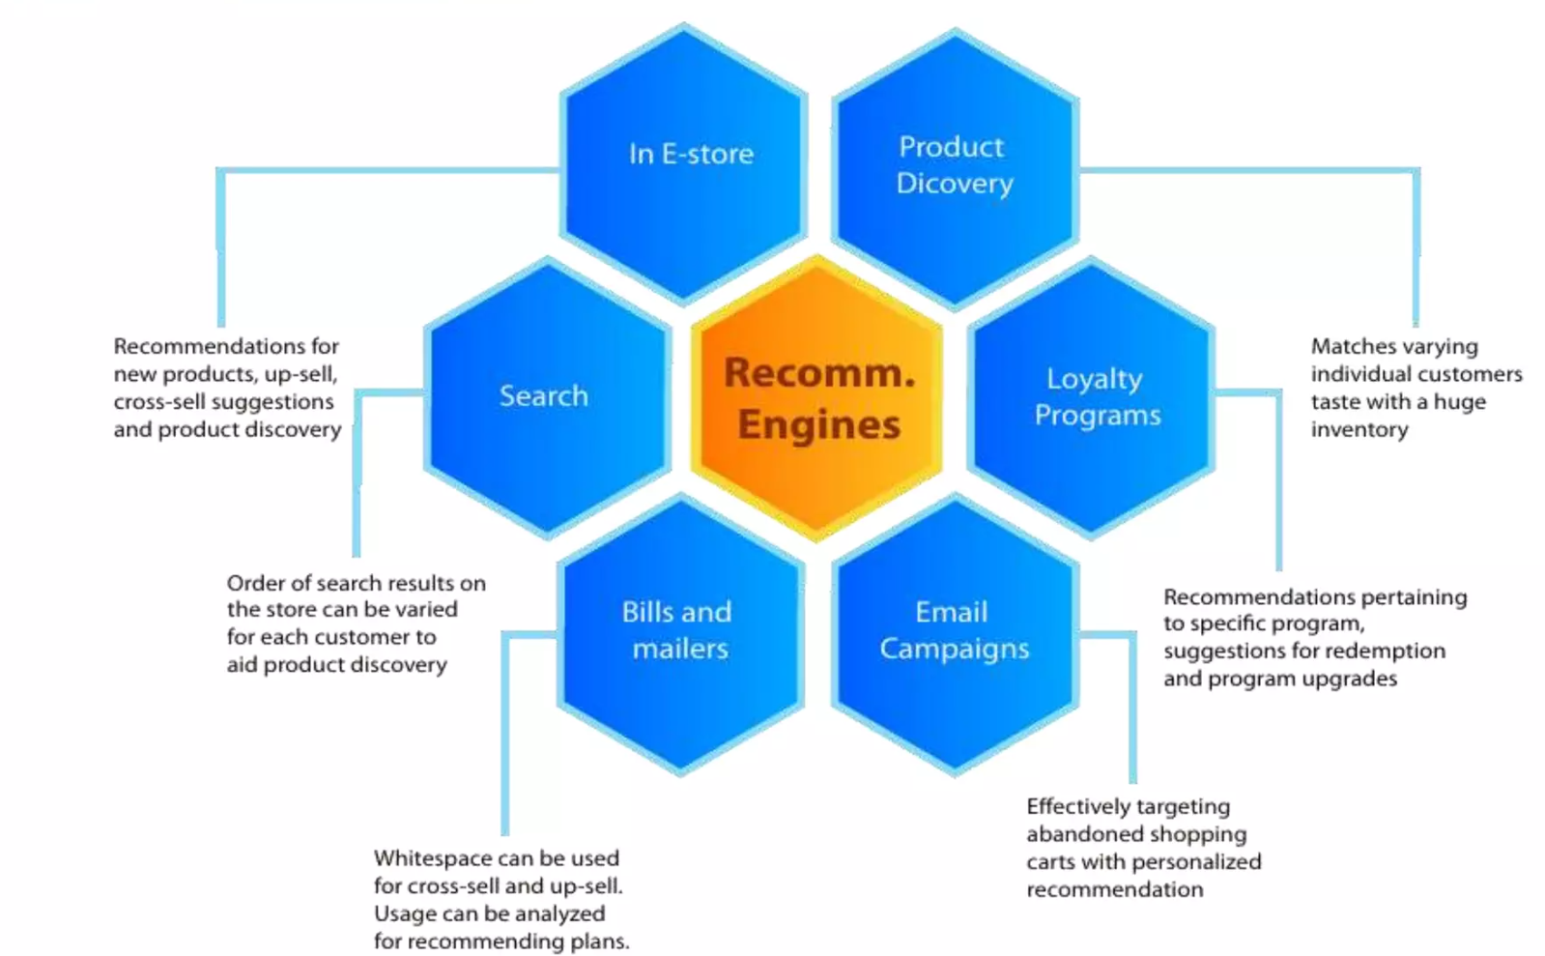
At the center of sales and marketing channels
Recommender Systems are a technological proxy for a social process. It automates aspects of a completely different information discovery model where people try to find other people with similar tastes and then ask them to suggest new things.
Enhance customer experience
Notes:
Business Outcomes
In the next five years, all major retail will be driving in the direction of personalization as a means to give customers a better buying experience. But many companies, especially those with eCommerce as a component, are challenged to gain deeper insights into buyer preferences because of limitations on their platform or in their data.
Data strategy needs to step out of IT and flow across all corners of your organization to provide a holistic view of customer information, sales data, macroeconomic influences, financial transactions, supply—everything that enables you to automate workflows, plan for future sales, proactively manage risk, and spend more time leading and innovating and less time mired in silos of disparate data.
By 2025 the top 10 retailers globally will leverage AI to facilitate prescriptive product recommendations, transaction, and forward deployment of inventory for immediate delivery. (need citation)

Slide 4
Next steps: How to engage?
Discovery Call
Proof of Value
Deployment
Call with the Customer to assess qualification to the program
Offering: 2-day CSU-led workshop with experts on Recommender Systems
CSU team, during the workshop, helps the interested customer build a Minimum Viable Product (MVP) using their own data and their own Azure subscription
Production Recommender System building (code-with) and deployment with guidance and support from the technical specialists (CSA) and Partners
30 minutes
1 or 2 days
4-8 weeks
Notes:
Next Steps – Transition to Tech Pitch
The next step is to take a deeper dive into how it works and discuss proof of value.
[Field Note: At this point, we transition from the business value discussion to a more technical portion of the deck. You may continue to walk through it with a TDM at this point or at a later date, as needed. The slide that follow will provide a demo for configuring the Accelerator).

Slide 5
2 Day Workshop Agenda
Day 1: Quick overview & setup of AI/ML environment in Customer Azure subscription
Day 2: Hands on - Customer use case model building and deployment
Time | Workshop Activity
9:00-11:30am (2.5 hours) | Quick Overview of Azure AI/ML Platforms & Services
 | Setup Unified Data Engineering, Analysis & AI Platform Environment (Storage & Azure Databricks)
 | Theory on Recommender Methods
11:30-12:30pm (1 hour) | Lunch
12:30-5:00pm (4.5 hours) | Provision & Configure Azure Machine Learning Services; Review Key Azure Machine Learning SDK for Python Concepts
 | Plan for Next Day – Deep dive to understand customer Recommender Use Case
Time | Workshop Activity
9:00-11:30am (2.5 hours) | Load Data, Visualization, Data Cleaning and Basic Feature Engineering. Each attendee: Loads data, performs data analysis & visualization to gain deep understanding of data towards predictive insights being targeted Initialize machine learning service to track training experiments for the recommender algorithms
11:30-12:30pm (1 hour) | Lunch
12:30-5:00pm (4.5 hours) | Create Model & Version Model Image (Docker Container Image) & Deploy Model Scoring Service to Azure Container Instance. Each attendee: Iteratively creates, tracks, reviews and tunes machine learning model using a couple of Recommender ML Frameworks ; Tracks model performance in Azure Machine Learning Workspace Creates Python-based model scoring script and converts the model to a RESTful API Docker Image Deploys model image to Azure Container Instance and Azure Kubernetes Service and scores against it

